Slide 1
GOLD NANOPARTICLES IN CHEMOTHERAPY
NAME:-AKASH.P.RAJPUT
ROLL NO:-35
CLASS-DIV:-TEME-B
GUIDED BY:-PROF.HARSHAL TAMBAT

Slide 2
1.Cancer is a group of diseases involving abnormal cell growth with the potential to invade or spread to other parts of the body.
2These contrast with benign tumors, which do not spread to other parts of the body.
3.Possible signs and symptoms include a lump, abnormal bleeding, prolonged cough, unexplained weight loss and a change in bowel movements.
4.While these symptoms may indicate cancer, they may have other causes. Over 100 types of cancers affect humans.
DEFINITION OF CANCER
AND IT’S CAUSES:-

Slide 3
GOLD NANOPARTICLES:-
1.Gold nanoparticles in chemotherapy and radiotherapy is the use of colloidal gold in therapeutic treatments, often for cancer or arthritis.
2.Gold nanoparticle technology shows promise in the advancement of cancer treatments. Some of the properties that gold nanoparticles possess, such as small size, non-toxicity and nonimmunogenicity make these molecules useful candidates for targeted drug delivery systems.
3.With tumor-targeting delivery vectors becoming smaller, the ability to by-pass the natural barriers and obstacles of the body becomes more probable.
4.To increase specificity and likelihood of drug delivery, tumor specific ligands may be grafted onto the particles along with the chemotherapeutic drug molecules, to allow these molecules to circulate throughout the tumor without being redistributed into the body.

Slide 4
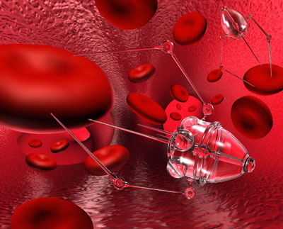
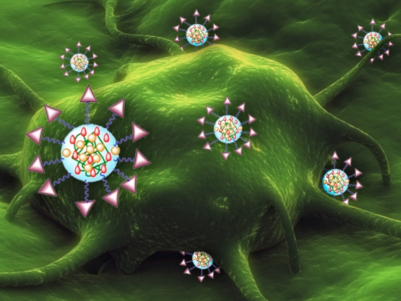
Nanotechnology cancer treatments uses gold particles to carry anticancer drugs straight to the cancer.

Slide 5
SYNTHESIS:-
1.A wide array of solution based approaches has been developed in the past few decades to control as the size, shape, and surface functionality.
2.Turkevich et al. developed a synthetic method for creating AuNPs in 1951 by treating hydrogen tetrachloroaurate (HAuCl4) with citric acid in boiling water, where the citrate acts as both reducing and stabilizing agent (Scheme 2B).
3.Frens further refined this method by changing the gold-to-citrate ratio to control particle size. This protocol has been widely employed to prepare dilute solutions of moderately stable spherical AuNPs with diameters of 10 to 20 nm, though larger AuNPs (e.g., 100 nm) can also be prepared.

Slide 6
1.BRUST METHOD:-
1.He achieved a breakthrough in AuNP synthesis in 1994 by creating organic soluble alkanethiol-stabilized AuNPs through a biphasic reduction protocol using tetraoctylammonium bromide (TOAB) as the phase transfer reagent and sodium borohydride(NaBH4) as the reducing agent (Scheme 2A).
2.This methodology produces low dispersity AuNPs from 1.5 to 5 nm by varying the reaction conditions such as gold-to-thiol ratio, reduction rate, and reaction temperature. These alkanethiol-protected AuNPs possess higher stability when compared to most other AuNPs due to the synergic effect of the strong thiol-gold interactions and van der Waals attractions between the ligands.

Slide 7
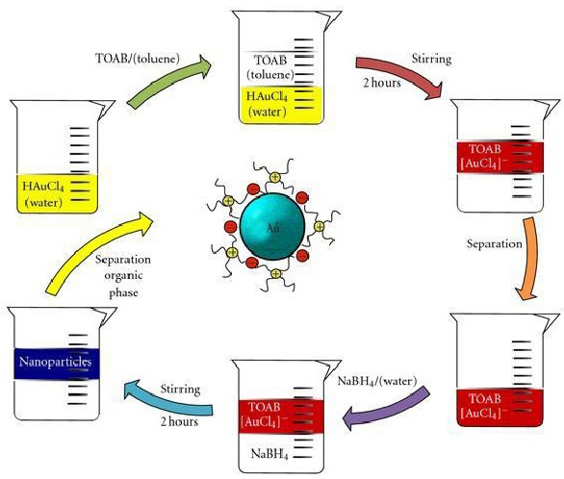

Slide 8
2.TURKEVICH METHOD:-
1.Small amounts of hot chlorauric acid is reacted with small amounts of sodium citrate solution.The colloidal gold will form because the citrate ions act as both reducing agents and capping agent.
2.Due to this monodisperse gold nanospheres are produced.
3.The size of nanospheres can be controlled by varying the citarte/gold ratio.
4.The major limitations of this method are low yield and the restriction of using water as solvent.

Slide 9
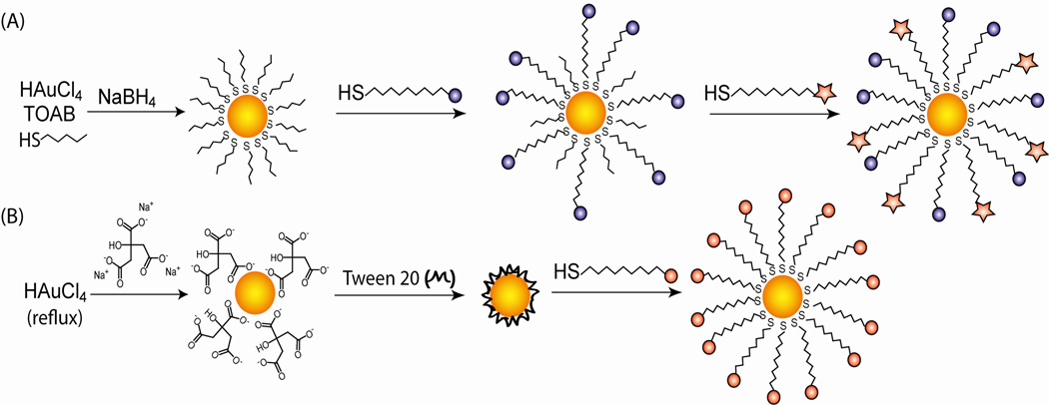
3.MARTIN METHOD:-
1.Gold nanoparticles are produced in water by reducing HAuCl4 with NaBH4. Even without any other stabilizer like citrate, gold nanoparticles are stably dispersed.
2.The key is to stabilize HauCl4 and NaBH4 in the aqueous stock solutions with HCl and NaOH for >3 months and >3 hours respectively.

Slide 10
MECHANISM:-
1.This can be done in several ways. Photodynamic therapy (PDT) involves a photosensitizer which becomes excited and generates singlet oxygen and other free radicals.
2.This method requires short wavelengths of light, reducing the depth to which the light can penetrate and making deep tumour treatment un- achievable.
3.Another method of cancer treatment using electromagnetic radiation is photothermal therapy (PTT). Using this method, near infrared (NIR) radiation from a laser may be used to penetrate through the skin to a deeper extent because the light will undergo less absorption from tissue chromophore and water.
4.Heat absorbed from the radiation will cause thermal denaturation and coagulation of affected cells. In addition, heating will cause vaporization of surrounding uids, producing cavitation bubble formation. This sudden formation of bubbles cause mechanical stress on the cells which lead to cell destruction

Slide 11
CHARACTERISTICS:-
1.Gold nanoparticles are chemically inert.
2.These have greater biological compatibility.
3.Optical properties like plasmon resonance are fluroscene and chemiluminscene having better exhibited by gold nanoparticles.
4.Gold Nanoparticles provide microscopic probes for the study of the cancer cell.
5.Gold nanoparticles accumlate in the cancerous cell and show cytotoxic effect i.e. necrosis of the specific cell and cell specific receptor.
6.These have high stability due to the gold-sulphur bonds.

Slide 12
TREATMENTS:-
1.Photothermal Cancer Therapy:-
1.It is direct method of accessing and destroying tumour cells.
2.This procedure is known to treat small tumours that are difficult to access and avoids the drawbacks (adverse effects) of conventional methods, including the unnecessary destruction of healthy tissues.
3.The cells are destroyed by exposure to light, rupturing membranes causing the release of digestive enzymes.
4.Hirsch et al observed that extreme heating in tumours would cause irreversible tissue damage including coagulation, cell shrinkage and loss of nuclear straining.
5.Results of their in vivo nanoshell therapy of mice revealed penetration of the tumor ~5mm. The metal particles were tuned to high absorption and scattering, resulting in effective conversion of light into heat covering a large surface area.

Slide 13
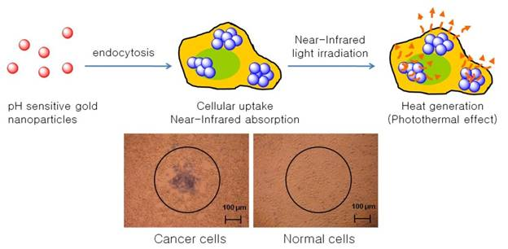
They determined that the NIR wavelengths were converted into heat on the picosecond timescale, allowing for short exposure of CW to minimize possible exposure to healthy cells.

Slide 14
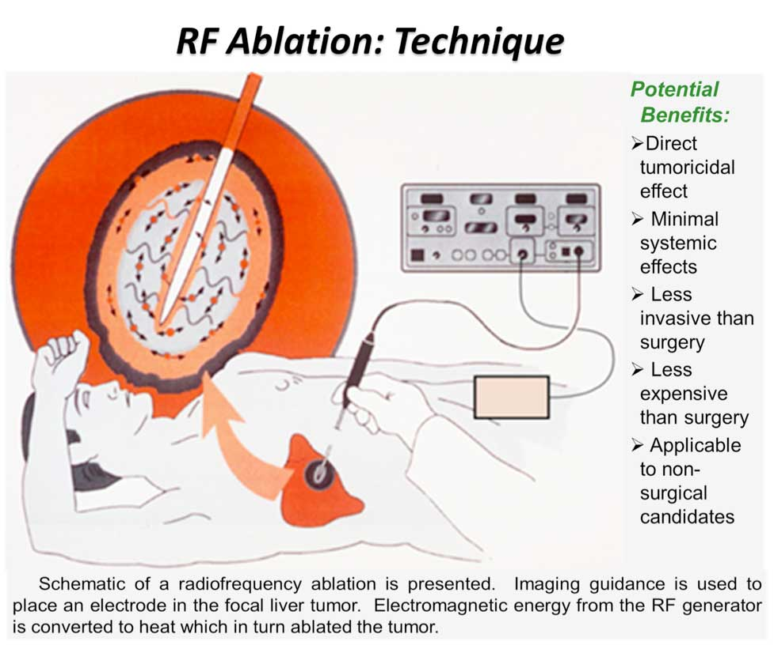
3.Radiofrequency Therapy:-
1.X-ray radiography procedures involves the diagnosis of cancer cells through the process of image acquisition. These techniques rely on the absorption of x-rays on the exposed tissue in order to improve image quality. In certain radiological procedures such as Radiofrequency therapy, a contrast agent is injected into the targeted cancer tissue and result in increased x-ray attenuation.

Slide 15
2.Radiofrequency therapy treatment involves the destruction of tumor cancer tissue cells through the differential heating of cancer tissue by radiofrequency diathermy. This differential heating is a result of the blood supply in the body carrying away the heat and cooling the heated tissue.
3.Gold nanoparticles are excellent absorbers of x-rays, due to its high atomic number of 197Au. This allows for a higher mass of the element, providing for a greater area of x-ray absorption. By acting as a contrast agent and injected into cancerous tumor cells, it would result in a higher dose of the cancerous tissue being exposed during radiotherapy treatment.

Slide 16
PROGRESS:-
1.Organo gold compounds has been prepared that are sufficiently stable under physiological conditions and are promising candidates for pharmacological testing as cytotoxic agent.
2.Gold is highly resistant to bacteria and can be used to prevent the growth in infections.
3.Gold nanoparticles are used in treatment of rheumatoid arthritis and other auto immune diseases.

Slide 17
CONCLUSION:-
Gold Nanoparticles have many properties that demonstrate their potential use in cancer diagnosis and therapy. They can be easily synthesized by chemical and biological methods without much need of sophistication. Their size and enhanced permeability and retention effect enables easy penetration and accumulation at tumor sites. GNPs have a high atomic number, which leads to greater resonant absorption of energy and provides greater contrast than standard agents. Further, GNPs are able to bind proteins and drugs targeted to cancer specific cell surface receptors.
They can be effectively employed in photothermal therapy due to surface plasmon resonant light absorption when exposed to the light of specific energy producing heat. Owing to these properties, there is great deal of excitement and interest among research community worldwide. However, issues related to evaluation of toxicity and mutagenic potential, large scale production for clinical use and implementation of standards for characterization and pre-clinical testing have to be addressed.

Slide 18
Thank you

